Slide 1

Online Examination System
LU Exam Hive

Slide 2
Designed & Crafted By:
Mohammed Saduzzaman Sadi
Mohi Uddin Pabel
Taufique Ahmed

Slide 3


An online examination system is a computer-based test system that can be used to conduct computer based tests online. This examination system uses fewer resources and reduces the need for question papers and answer scripts, exam room scheduling, arranging invigilators, coordinating with examiners, and more.

Slide 4

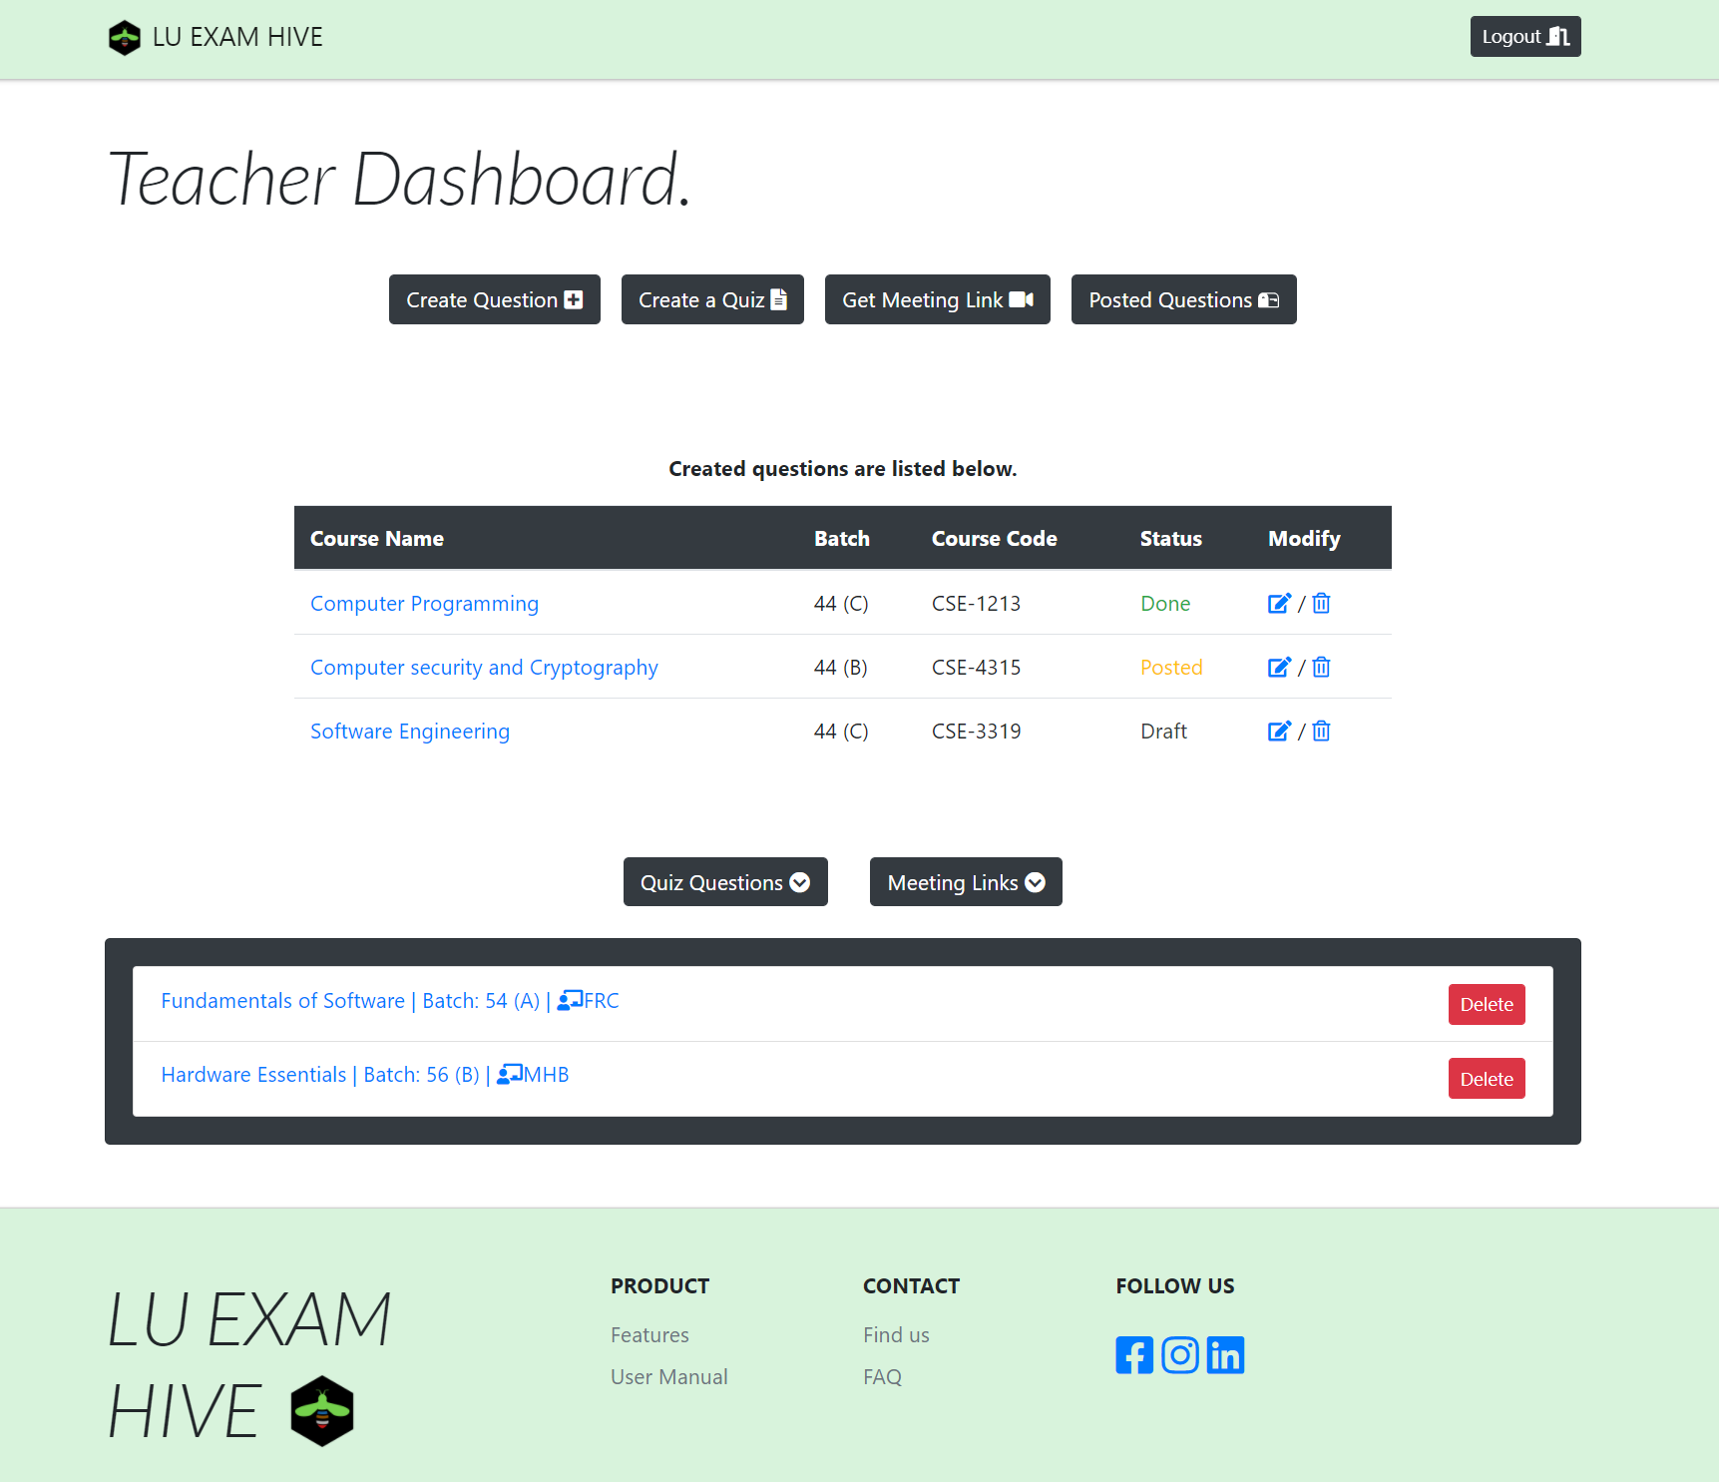


Widely Used
Integrated
LU Exam Hive

Slide 5



Audience
Teacher
No More:
Complex
UI
Student
Focused
on :
Easy
UI
Admin

Slide 6

Vision
“Reach the heights”
LU Exam Hive

Slide 7
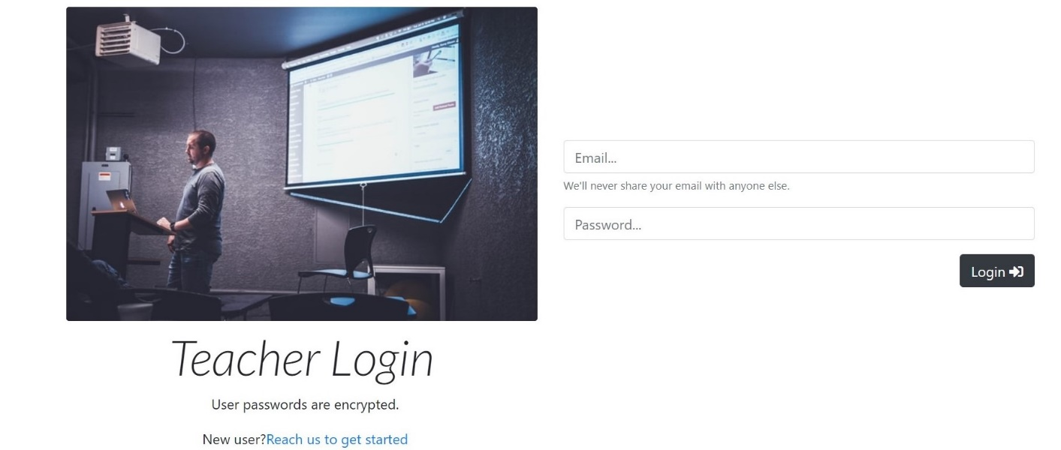
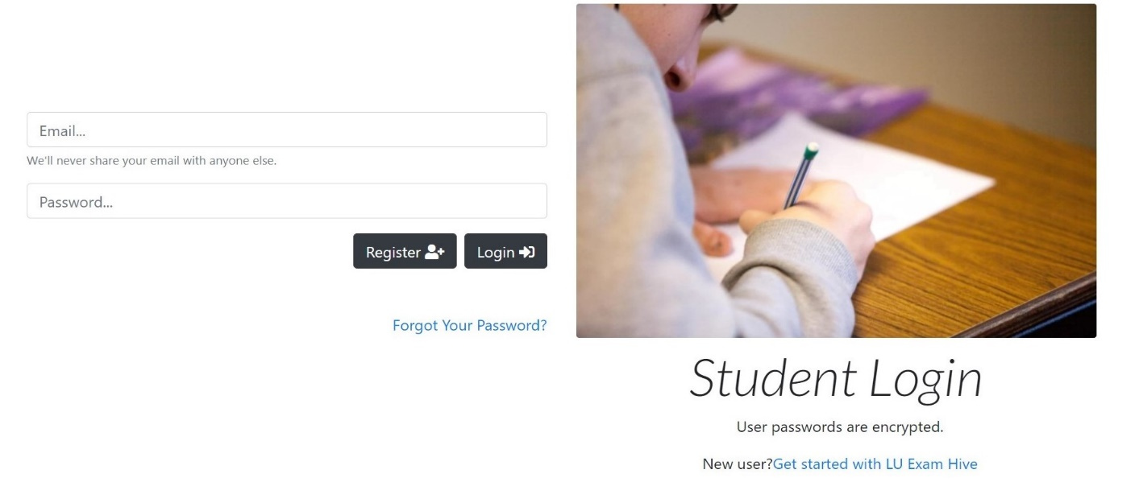
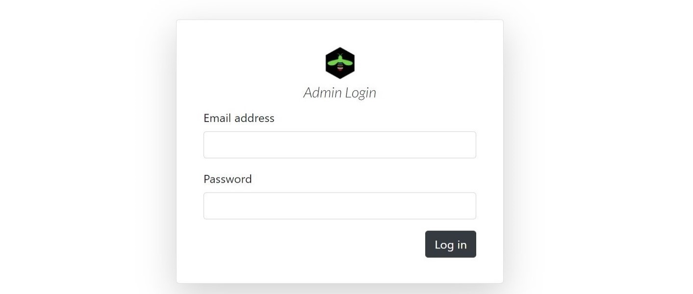
Avatars
Teacher Avatar
Student Avatar
Admin Avatar

Slide 8


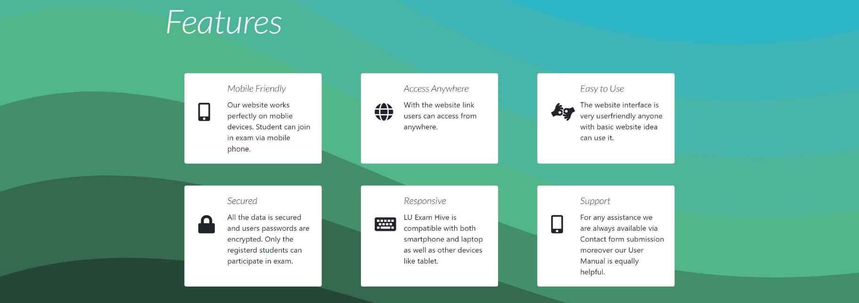
SVG
SVG stands for Scalable Vector Graphics. It is used to define vector-based graphics for the Web. Every element and every attribute in SVG files can be animated.

